Slide 1
CURSE OF DIMENSIONALITY

Slide 2
Consider an example
We have a set of images, each of which depicts either a cat or a dog.
We would like to create a classifier that is able to distinguish dogs from cats automatically.

Slide 3
We first need to think about a descriptor for each object class that can be expressed by numbers, such that a mathematical algorithm,
i.e. a classifier, can use these numbers to recognize the object.

Slide 4
For instance
cats and dogs generally differ in color.
A possible descriptor that discriminates these two classes could then consist of three number
the average red color,
the average green color
the average blue color
of the image under consideration.

Slide 5
A simple linear classifier for instance, could combine these features linearly to decide on the class label:
If 0.5*red + 0.3*green + 0.2*blue > 0.6 :
return cat; else
return dog;
These three color-describing numbers, called features, will obviously not suffice to obtain a perfect classification.

Slide 6
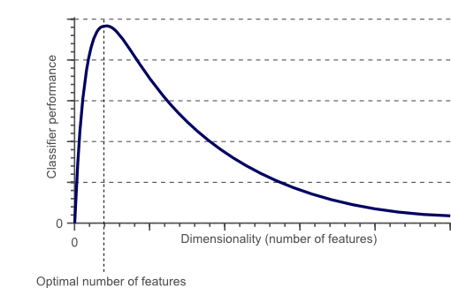
To obtain an even more accurate classification, we could add more features, based on color or texture histograms, statistical moments, etc.
In fact, after a certain point, increasing the dimensionality of the problem by adding new features would actually degrade the performance of our classifier.

Slide 7
As the dimensionality increases, the classifier’s performance increases until the optimal number of features is reached.
Further increasing the dimensionality without increasing the number of training samples results in a decrease in classifier performance.

Slide 8
THE CURSE OF DIMENSIONALITY AND OVERFITTING
In the earlier example of cats and dogs, let’s assume there are an infinite number of cats and dogs living on our planet.
However, due to our limited time and processing power, we were only able to obtain 10 pictures of cats and dogs.
The end-goal in classification is then to train a classifier based on these 10 training instances, that is able to correctly classify the infinite number of dog and cat instances which we do not have any information about.

Slide 9
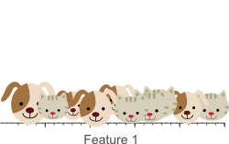
Now let’s use a simple linear classifier and try to obtain a perfect classification. We can start by a single feature, e.g. the average ‘red’ color in the image:
A single feature does not result in a perfect separation of our training data.
10 training instances covered the complete 1D feature space,
the width of which was 5 unit intervals.
the sample density was 10/5=2 samples/interval.

Slide 10
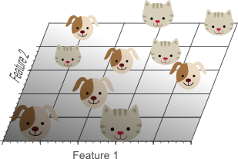
Adding a second feature still does not result in a linearly separable classification problem: No single line can separate all cats from all dogs in this example.
10 training instances
which now cover a 2D feature space with an area of 5×5=25 unit squares. The sample density was 10/25 = 0.4 samples/interval.

Slide 11
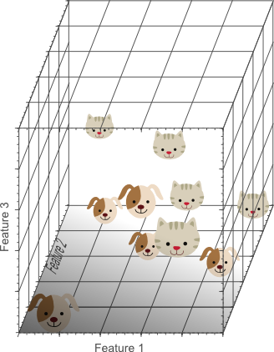
Adding a third feature results in a linearly separable classification problem in our example. A plane exists that perfectly separates dogs from cats.
the 10 samples had to cover a feature space volume of 5x5x5=125 unit cubes.
the sample density was 10/125 = 0.08 samples/interval.

Slide 12
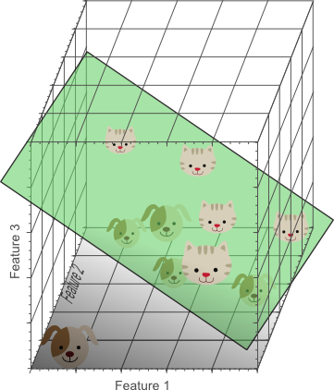
In the three-dimensional feature space, we can now find a plane that perfectly separates dogs from cats.
This means that a linear combination of the three features can be used to obtain perfect classification results on our training data of 10 images:

Slide 13
If we would keep adding features, the dimensionality of the feature space grows, and becomes sparser and sparser.
Due to this sparsity, it becomes much more easy to find a separable hyperplane because the likelihood that a training sample lies on the wrong side of the best hyperplane becomes infinitely small when the number of features becomes infinitely large.
However, if we project the highly dimensional classification result back to a lower dimensional space, a serious problem associated with this approach becomes evident:

Slide 14
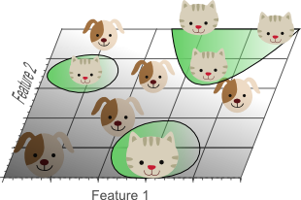
Using too many features results in overfitting. The classifier starts learning exceptions that are specific to the training data and do not generalize well when new data is encountered.
This shows the 3D classification results, projected onto a 2D feature space. Whereas the data was linearly separable in the 3D space, this is not the case in a lower dimensional feature space. In fact, adding the third dimension to obtain perfect classification results, simply corresponds to using a complicated non-linear classifier in the lower dimensional feature space. As a result, the classifier learns the appearance of specific instances and exceptions of our training dataset. Because of this, the resulting classifier would fail on real-world data, consisting of an infinite amount of unseen cats and dogs that often do not adhere to these exceptions.

Slide 15
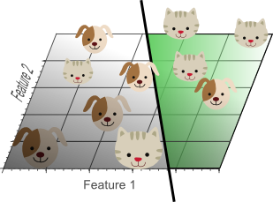
This concept is called overfitting and is a direct result of the curse of dimensionality. This shows the result of a linear classifier that has been trained using only 2 features instead of 3:
Although the training data is not classified perfectly, this classifier achieves better results on unseen data.

Slide 16
Although the simple linear classifier with decision boundaries seems to perform worse than the non-linear classifier, this simple classifier generalizes much better to unseen data because it did not learn specific exceptions that were only in our training data by coincidence.
In other words, by using less features, the curse of Dimensionality was avoided such that the classifier did not over-fit the training data.

Slide 17
Let’s say we want to train a classifier using only a single feature whose value ranges from 0 to 1. Let’s assume that this feature is unique for each cat and dog. If we want our training data to cover 20% of this range, then the amount of training data needed is 20% of the complete population of cats and dogs.
Now, if we add another feature, resulting in a 2D feature space, things change; To cover 20% of the 2D feature range, we now need to obtain 45% of the complete population of cats and dogs in each dimension (0.45^2 = 0.2).
In the 3D case this gets even worse: to cover 20% of the 3D feature range, we need to obtain 58% of the population in each dimension (0.58^3 = 0.2).

Slide 18
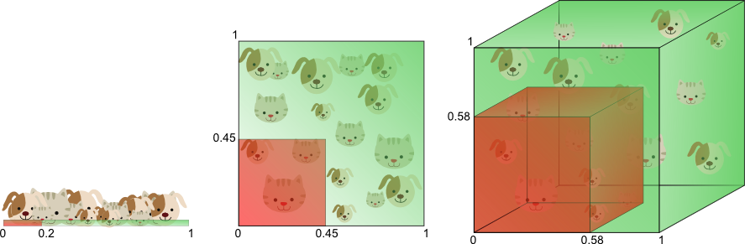
The amount of training data needed to cover 20% of the feature range grows exponentially with the number of dimensions.

Slide 19
In other words, if the amount of available training data is fixed, then overfitting occurs if we keep adding dimensions.
On the other hand, if we keep adding dimensions, the amount of training data needs to grow exponentially fast to maintain the same coverage and to avoid overfitting.

Slide 20
In the above example, the curse of dimensionality introduces sparseness of the training data.
The more features we use, the more sparse the data becomes such that accurate estimation of the classifier’s parameters (i.e. its decision boundaries) becomes more difficult.
Another effect of the curse of dimensionality, is that this sparseness is not uniformly distributed over the search space. In fact, data around the origin (at the center of the hypercube) is much more sparse than data in the corners of the search space.

